Slide 1

Predicting the Car Price

Slide 2



Problem Statement :
A Chinese automobile company Greely Auto aspires to enter the US market by setting up their manufacturing unit there and producing cars locally to give competition to their US and European counterparts.
They have contracted an automobile consulting company to understand the factors on which the pricing of cars depends. Specifically, they want to understand the factors affecting the pricing of cars in the American market, since those may be very different from the Chinese market. The company wants to know:
- Which variables are significant in predicting the price of a car
- How well those variables describe the price of a car

Slide 3
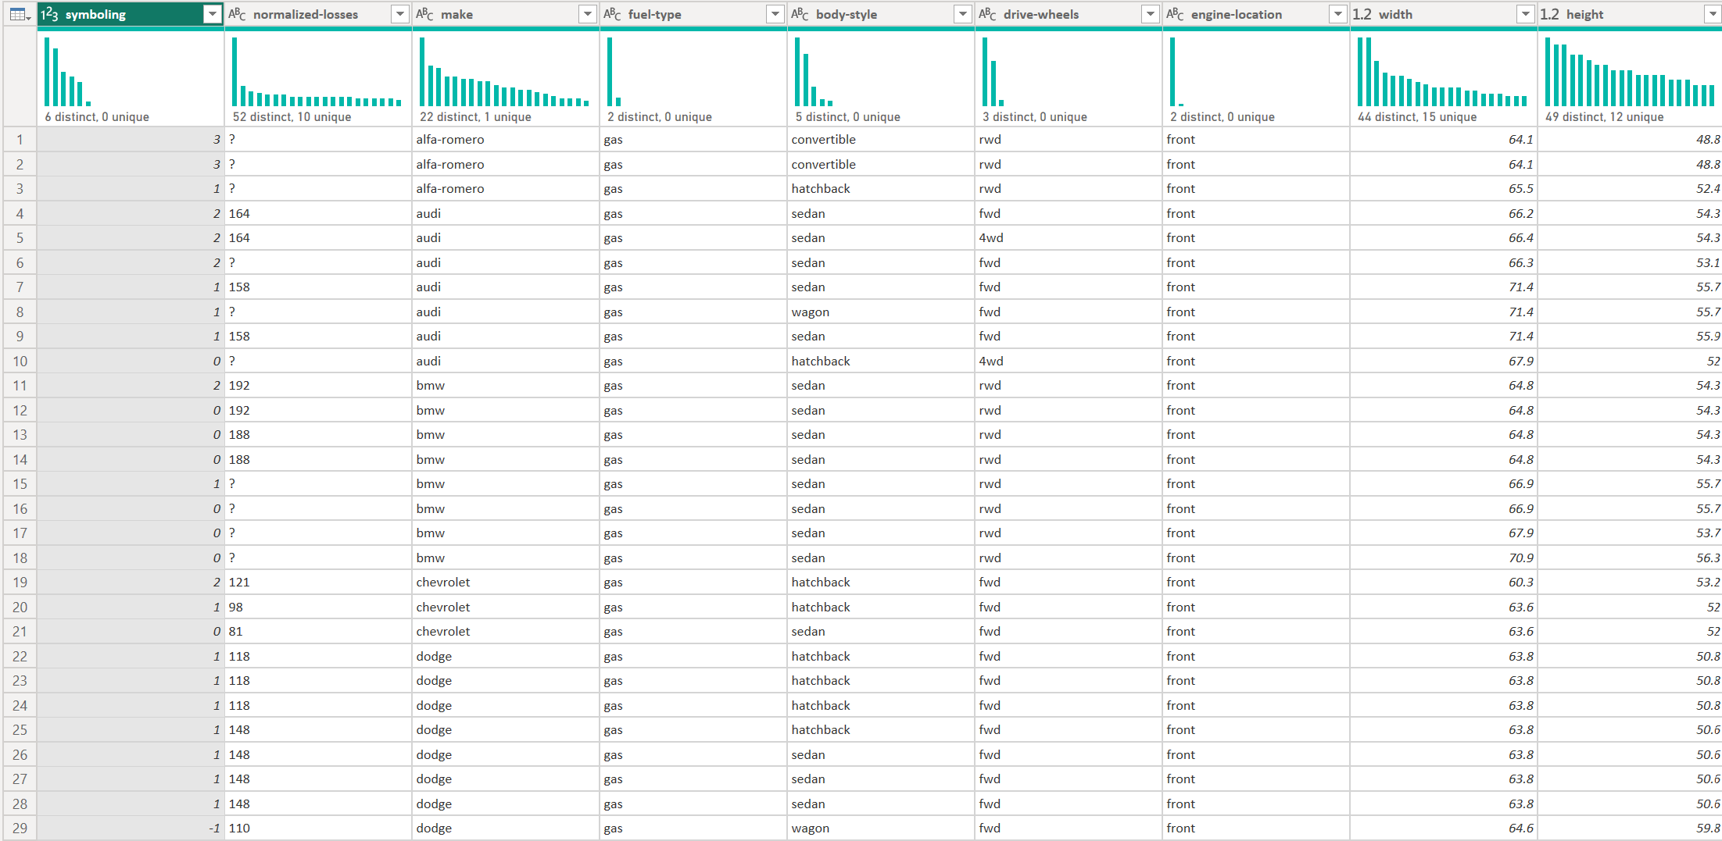
Data Set :

Slide 4
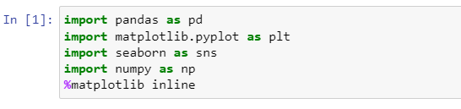
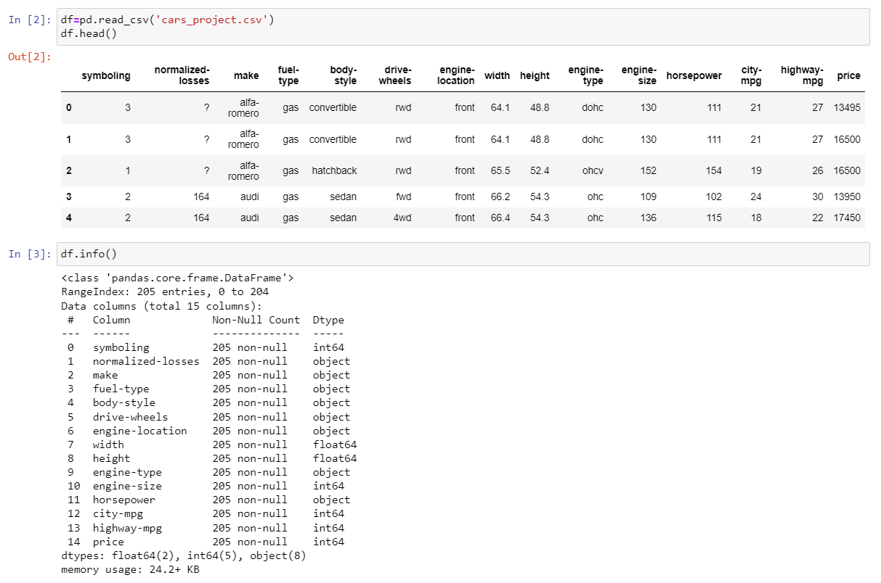
1) Importing Required Libraries:
2) Loading the Dataset:

Slide 5
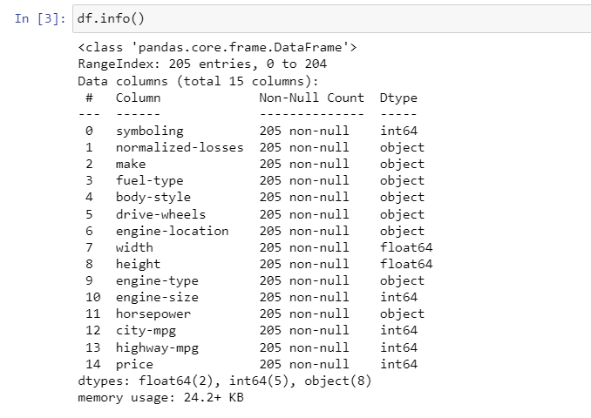
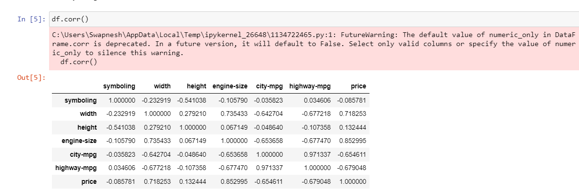
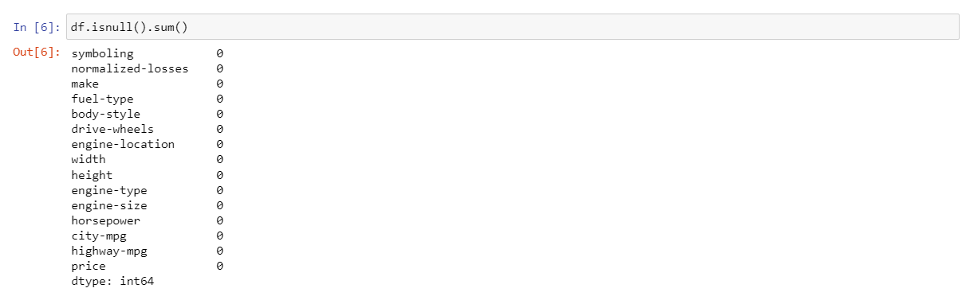
3) Exploratory Data Analysis
a. Understanding the dataset

Slide 6
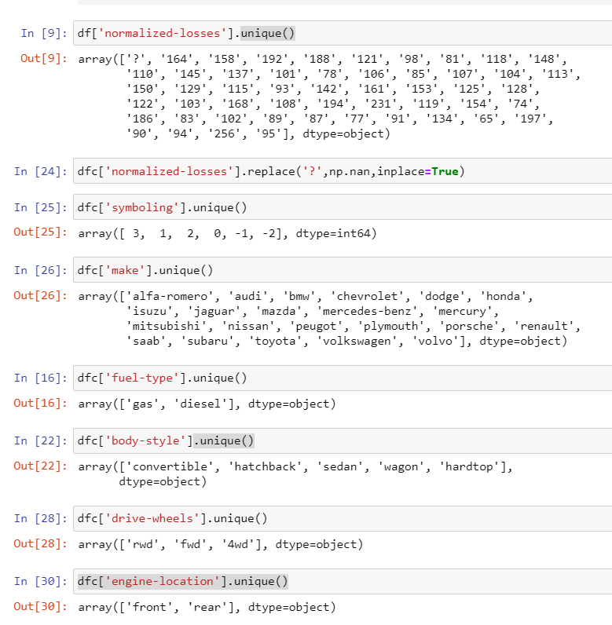
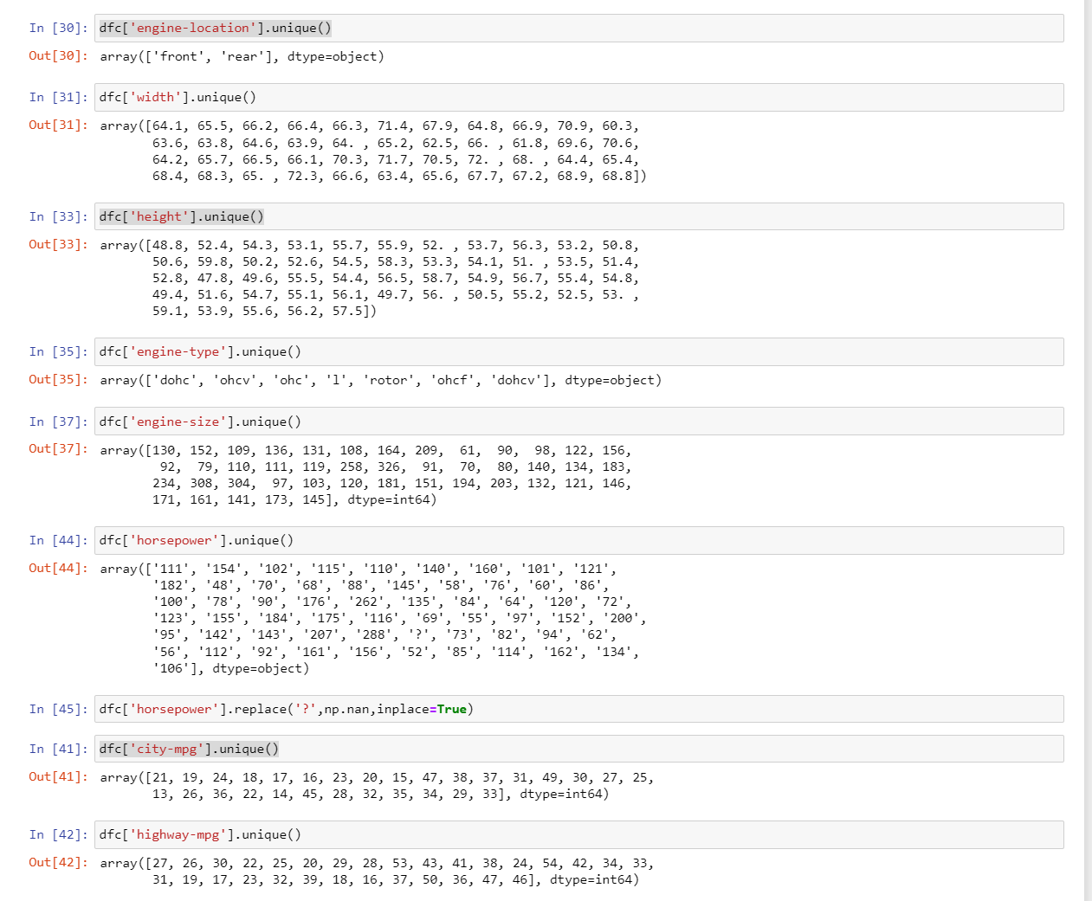
CONCLUSION :- We observe that unique value of some attributes are ‘?’ so we are getting 0 null when we try to get isnull() , So lets replace them with null values nan .

Slide 7
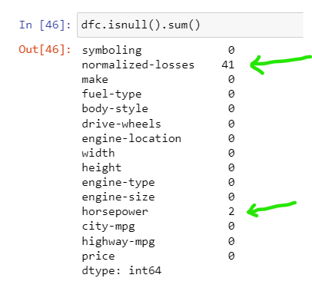

a. Data Cleaning
1. Replacing ? With nan
2. Checking null values in data set after replacement
3. Changing the data type of some attributes

Slide 8
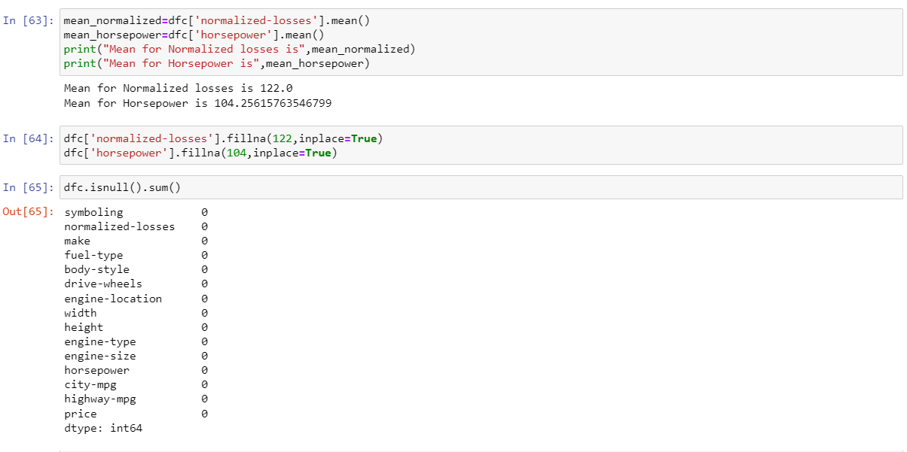
4.Calulating mean and replacing with null values

Slide 9
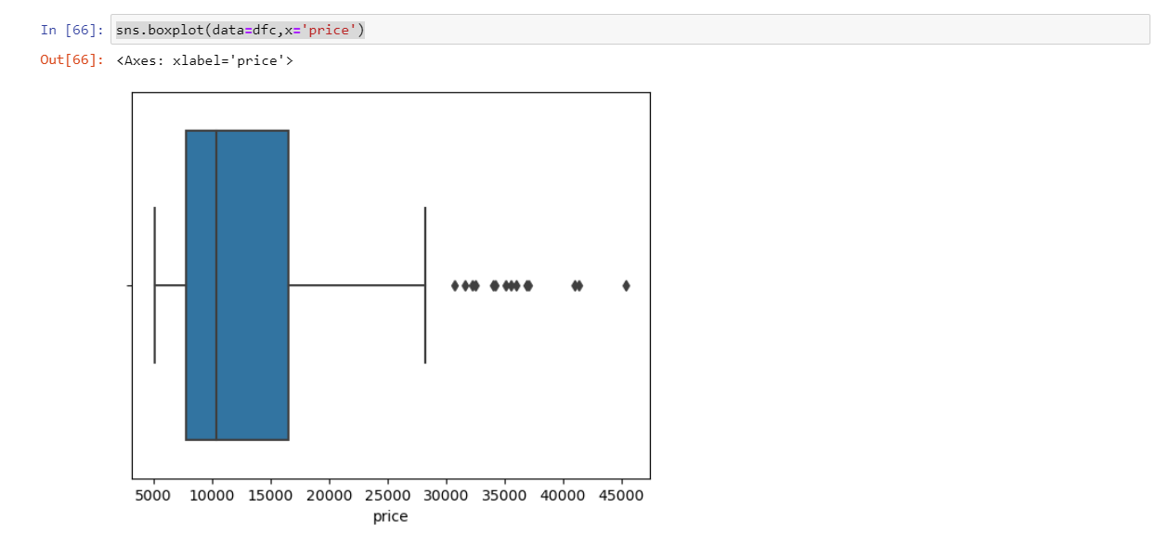
3) Handling the Outliers
CONCLUSION :- As we see there are many outliers above 30k but if we remove all this outliers we will be loosing our precious data because price for some high brand cars starts from 30k so we need to plot boxplot for price with maker(brands)

Slide 10
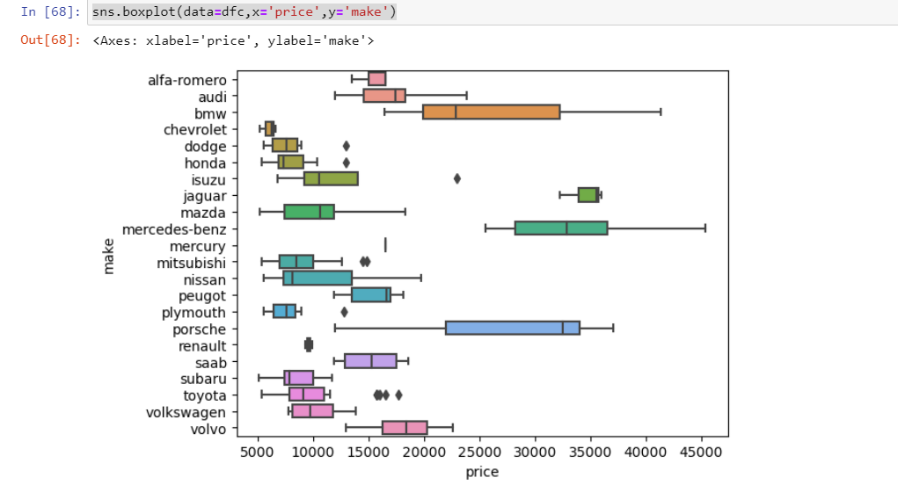
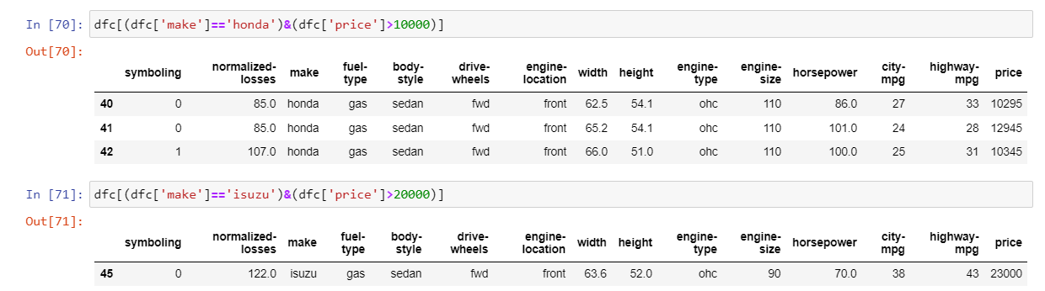
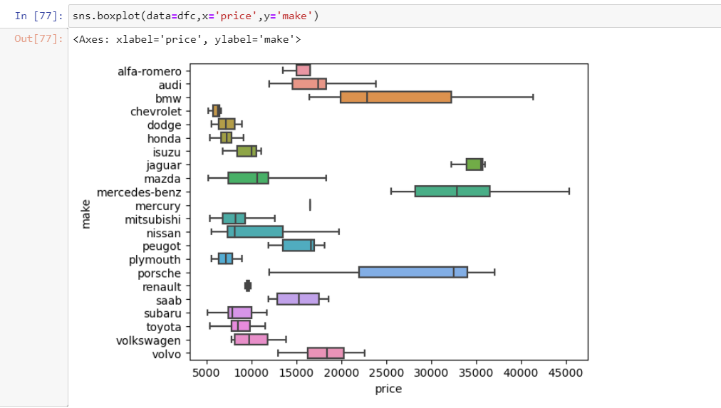
Boxplot as per Brands and then finding outliers
Finding the sr.no. for outliers by condition on price and make using and(&) operator

Slide 11
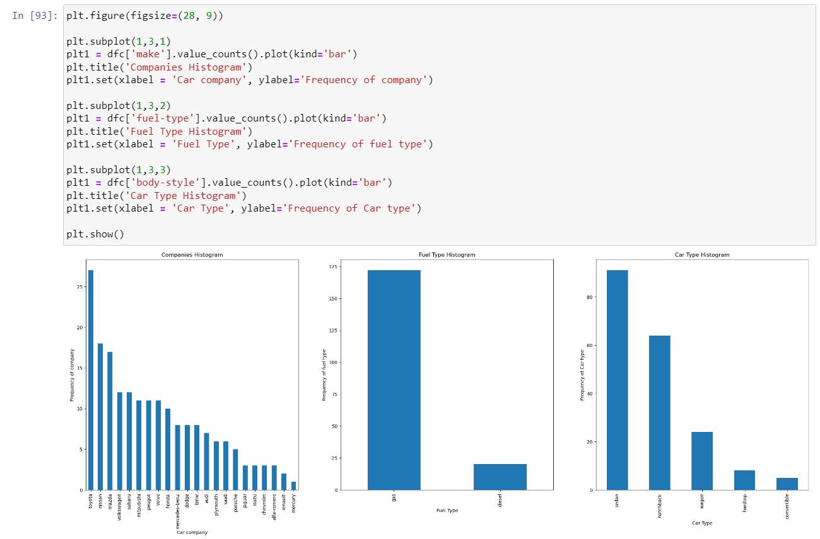
4) Visualize the data
a. Categorical data
CONCLUSION
Toyota seemed to be favored car company.
Number of gas fueled cars are more than diesel.
sedan is the top car type preferred.

Slide 12
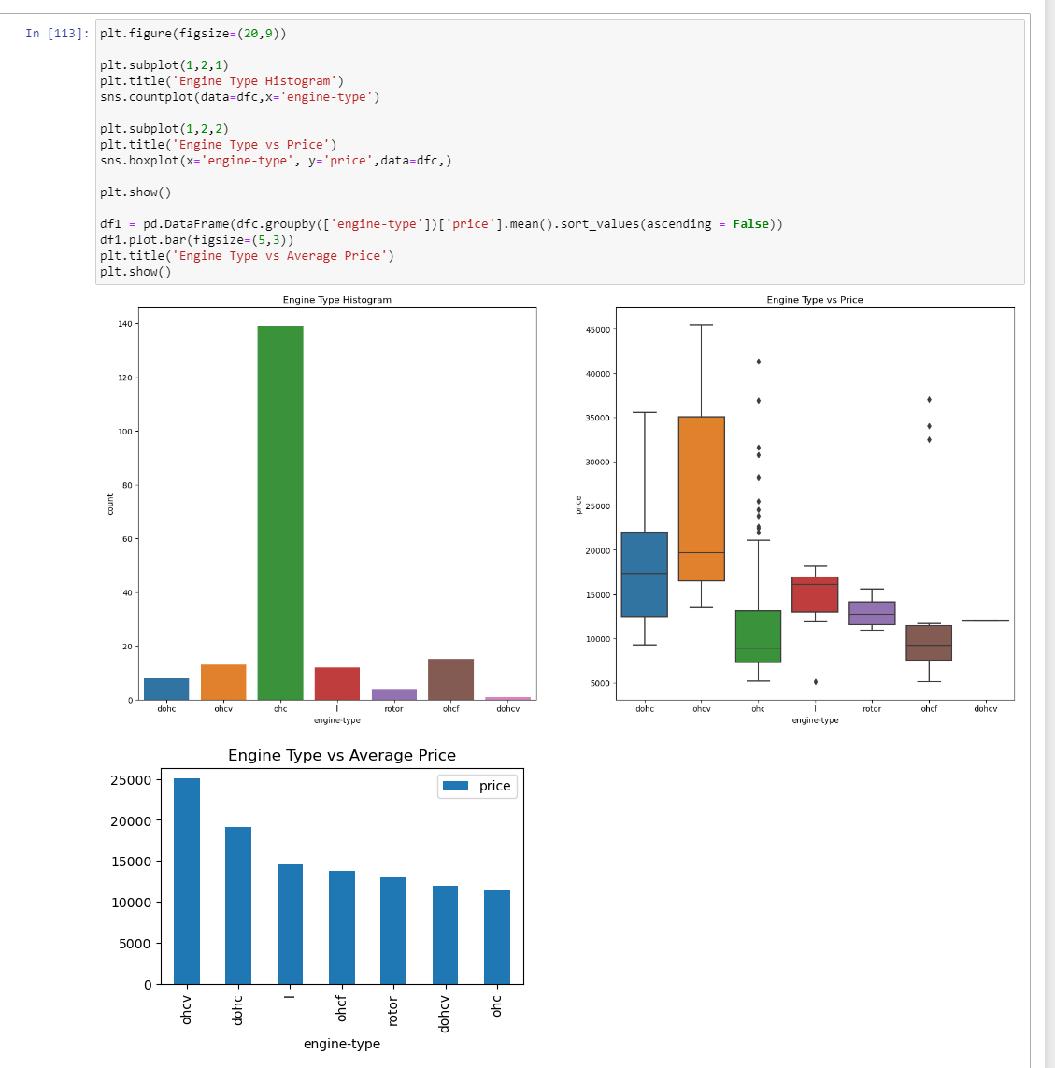
CONCLUSION
ohc Engine type seems to be most favored type.
ohcv has the highest price range (While dohcv has only one row), ohc and ohcf have the low price range.

Slide 13
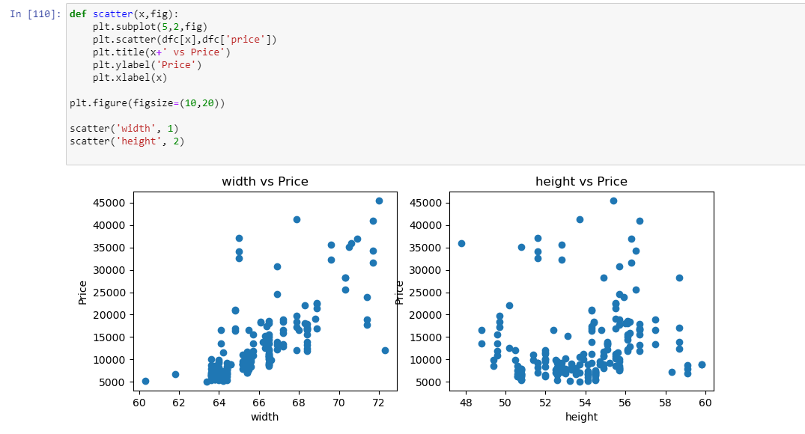
a. Numerical Data
CONCLUSION
Car width seems to have a positive correlation with price.
Car height doesn't show any significant trend with price.

Slide 14
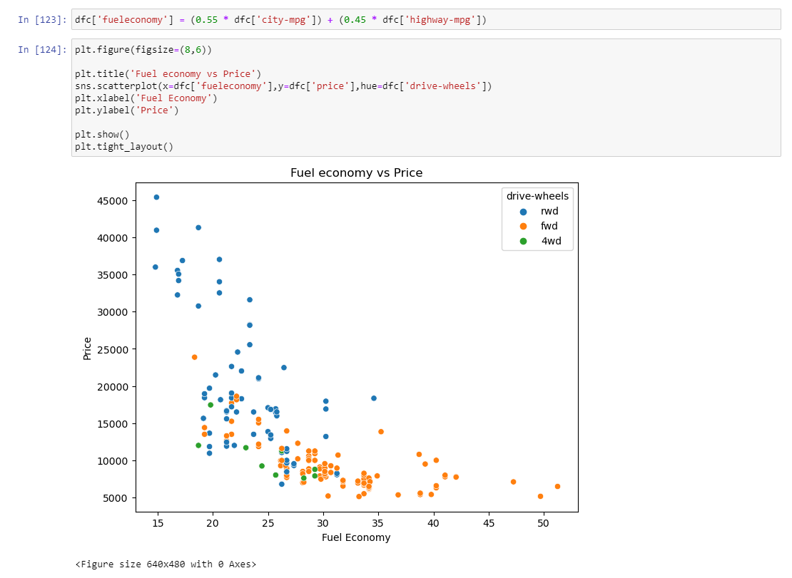
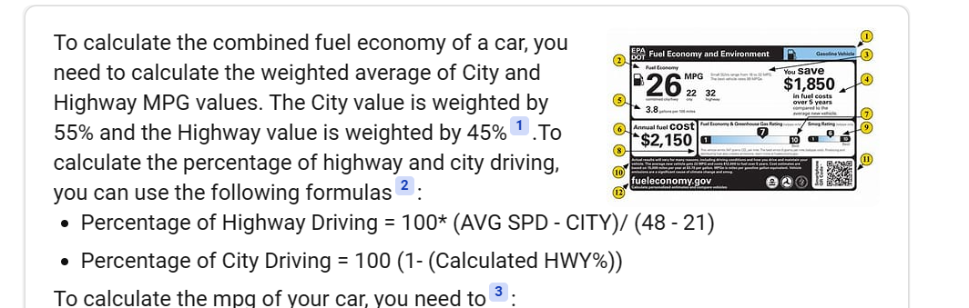
5) Deriving new features
CONCLUSION
Fuel economy has an obvious negative correlation with price and is significant.

Slide 15
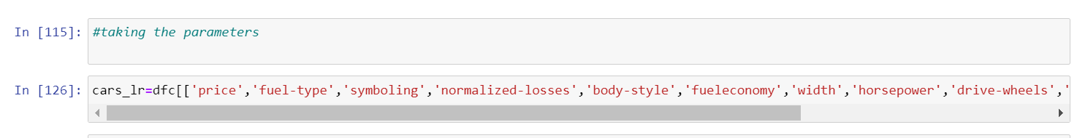
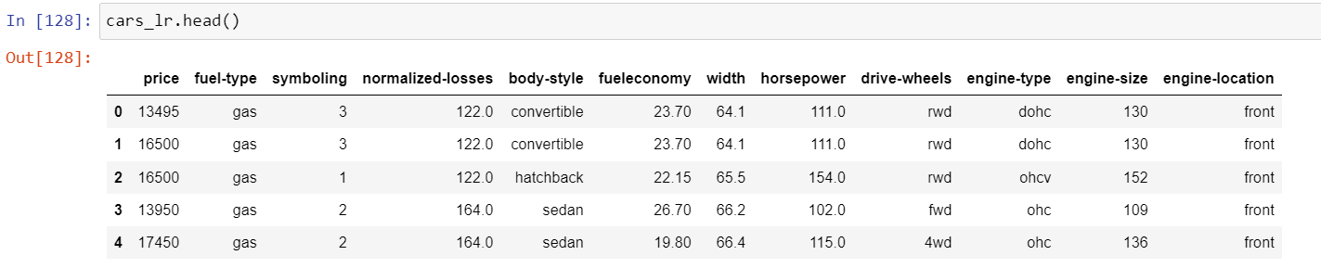
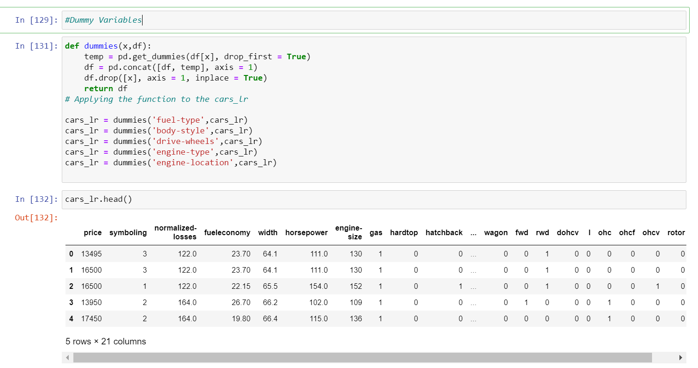
6) Sorting the attributes and taking dummies for categorical data

Slide 16
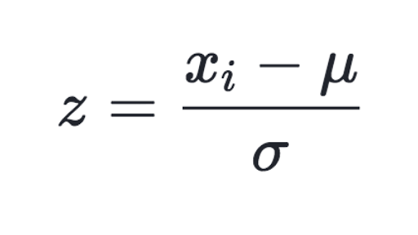
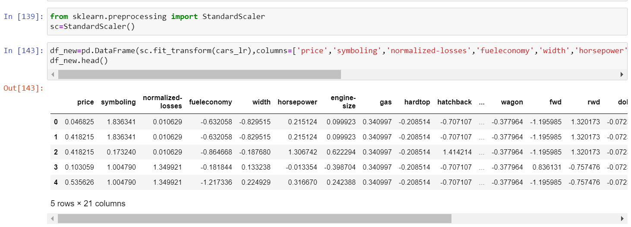
7) Scaling Data
We can imagine how the feature with greater range with overshadow or dimenish the smaller feature completely and this will impact the performance of all distance based model as it will give higher weightage to variables which have higher magnitude

Slide 17
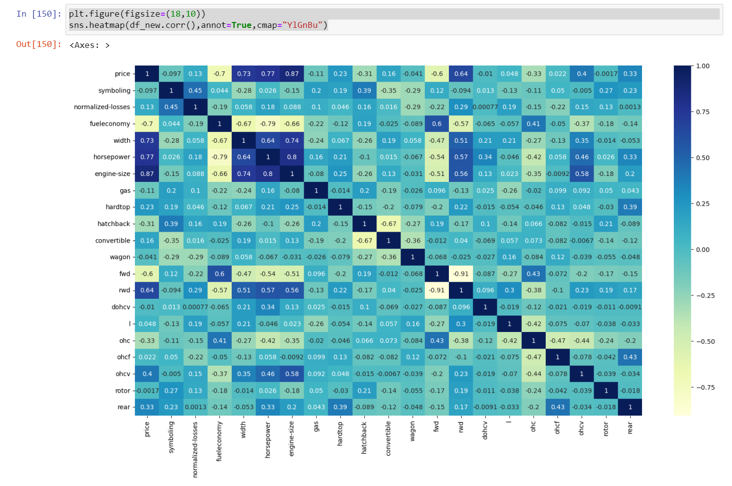
8) Feature Correlation
CONCLUSION
Highly correlated variables to price are - width, engine size, horse power and rwd

Slide 18
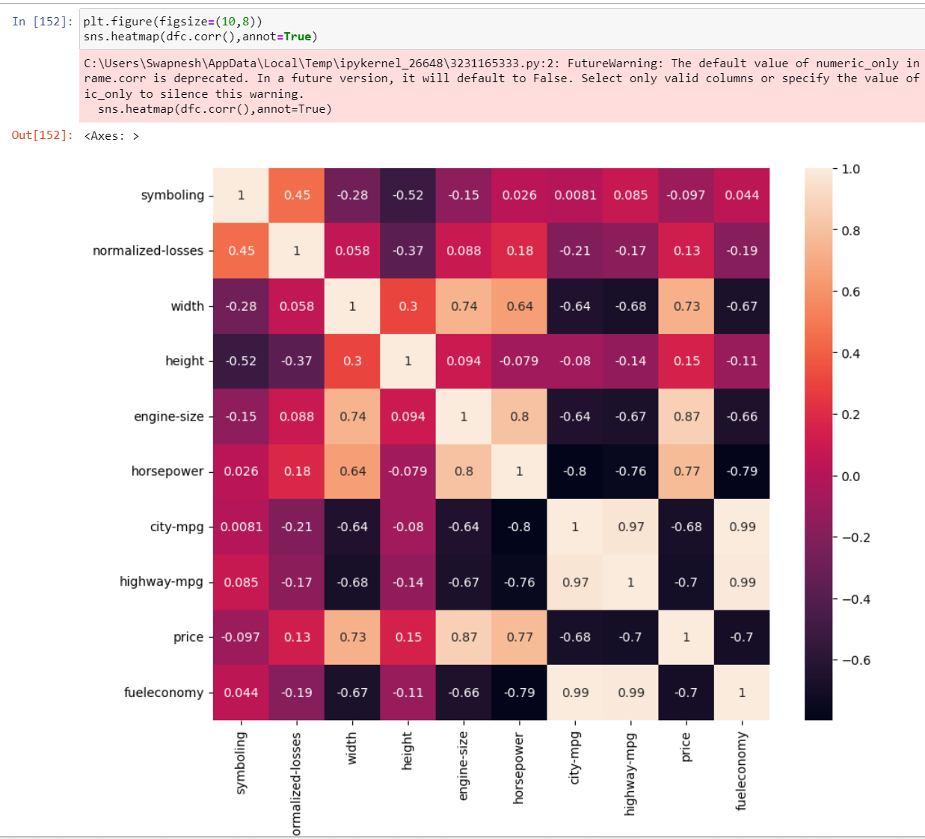
Feature Corelation before encoding categorical attributes and scaling the data

Slide 19
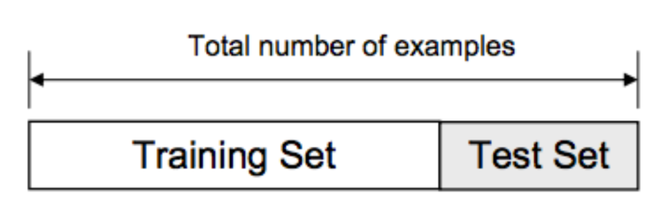
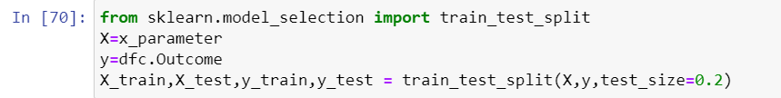
9) Train Test Split Data
Train Test Split : To have unknown datapoints to test the data rather than testing with the same points with which the model was trained. This helps capture the model performance much better.

Slide 20
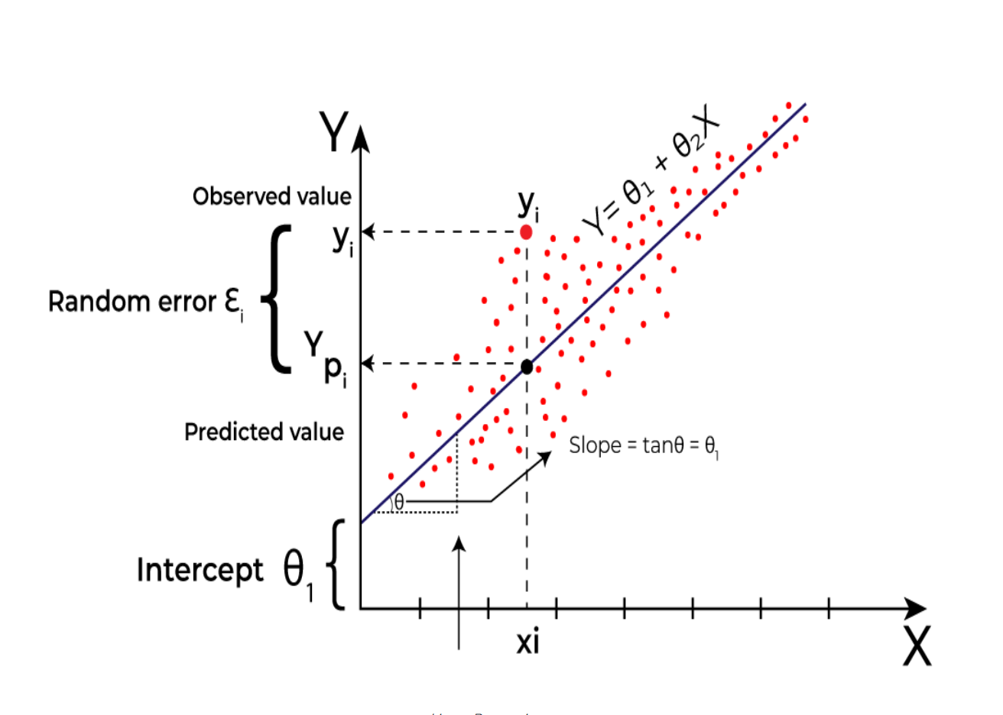
10) Linear Regression
Linear regression is a type of supervised machine learning algorithm that computes the linear relationship between a dependent variable and one or more independent features. When the number of the independent feature, is 1 then it is known as Univariate Linear regression, and in the case of more than one feature, it is known as multivariate linear regression.

Slide 21
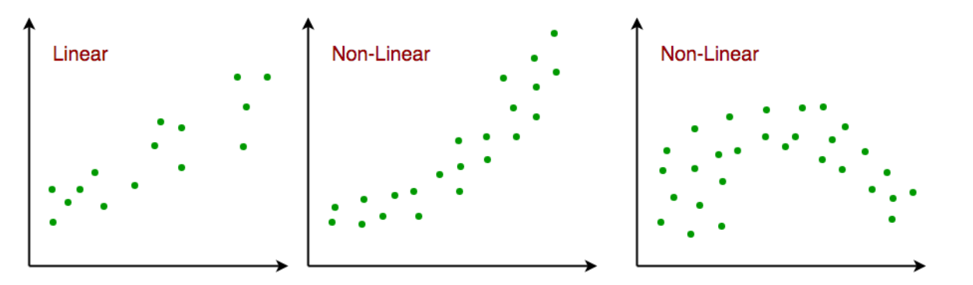
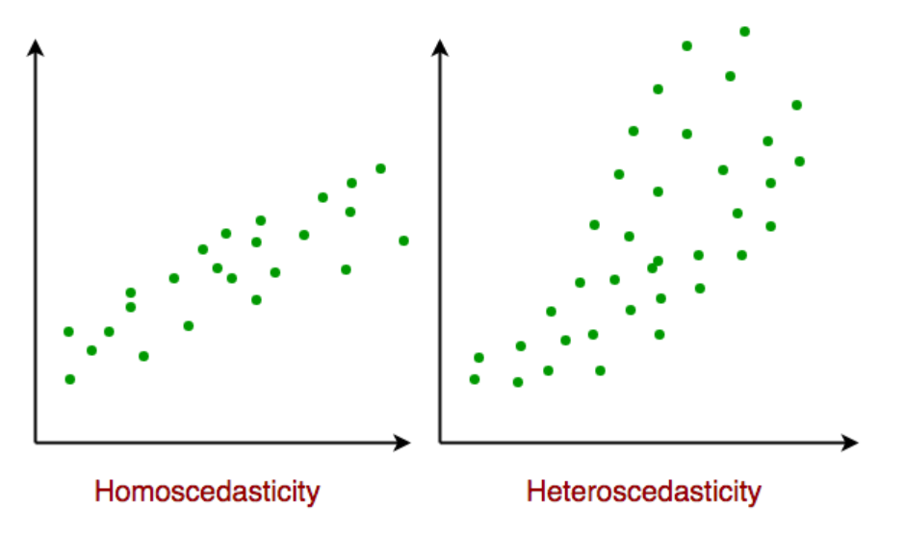
Assumption for Linear Regression Model
Linear regression is a powerful tool for understanding and predicting the behaviour of a variable, however, it needs to meet a few conditions in order to be accurate and dependable solutions.
Linearity:
2.Independence: The observations in the dataset are independent of each other. This means that the value of the dependent variable for one observation does not depend on the value of the dependent variable for another observation.
3.Homoscedasticity: Across all levels of the independent variable(s), the variance of the errors is constant.

Slide 22
Normality: The residuals should be normally distributed. This means that the residuals should follow a bell-shaped curve. If the residuals are not normally distributed, then linear regression will not be an accurate model.
No multicollinearity: There is no high correlation between the independent variables. This indicates that there is little or no correlation between the independent variables.Multicollinearity occurs when two or more independent variables are highly correlated with each other, which can make it difficult to determine the individual effect of each variable on the dependent variable. If there is multicollinearity, then linear regression will not be an accurate model.

Slide 23
Types of Linear Regression
There are two main types of linear regression:
Simple Linear Regression: This is the simplest form of linear regression, and it involves only one independent variable and one dependent variable. The equation for simple linear regression is: where:
Y is the dependent variable
X is the independent variable
β0 is the intercept
β1 is the slope
Multiple Linear Regression: This involves more than one independent variable and one dependent variable. The equation for multiple linear regression is: where:
Y is the dependent variable
X1, X2, …, Xp are the independent variables
β0 is the intercept
β1, β2, …, βn are the slopes

Slide 24
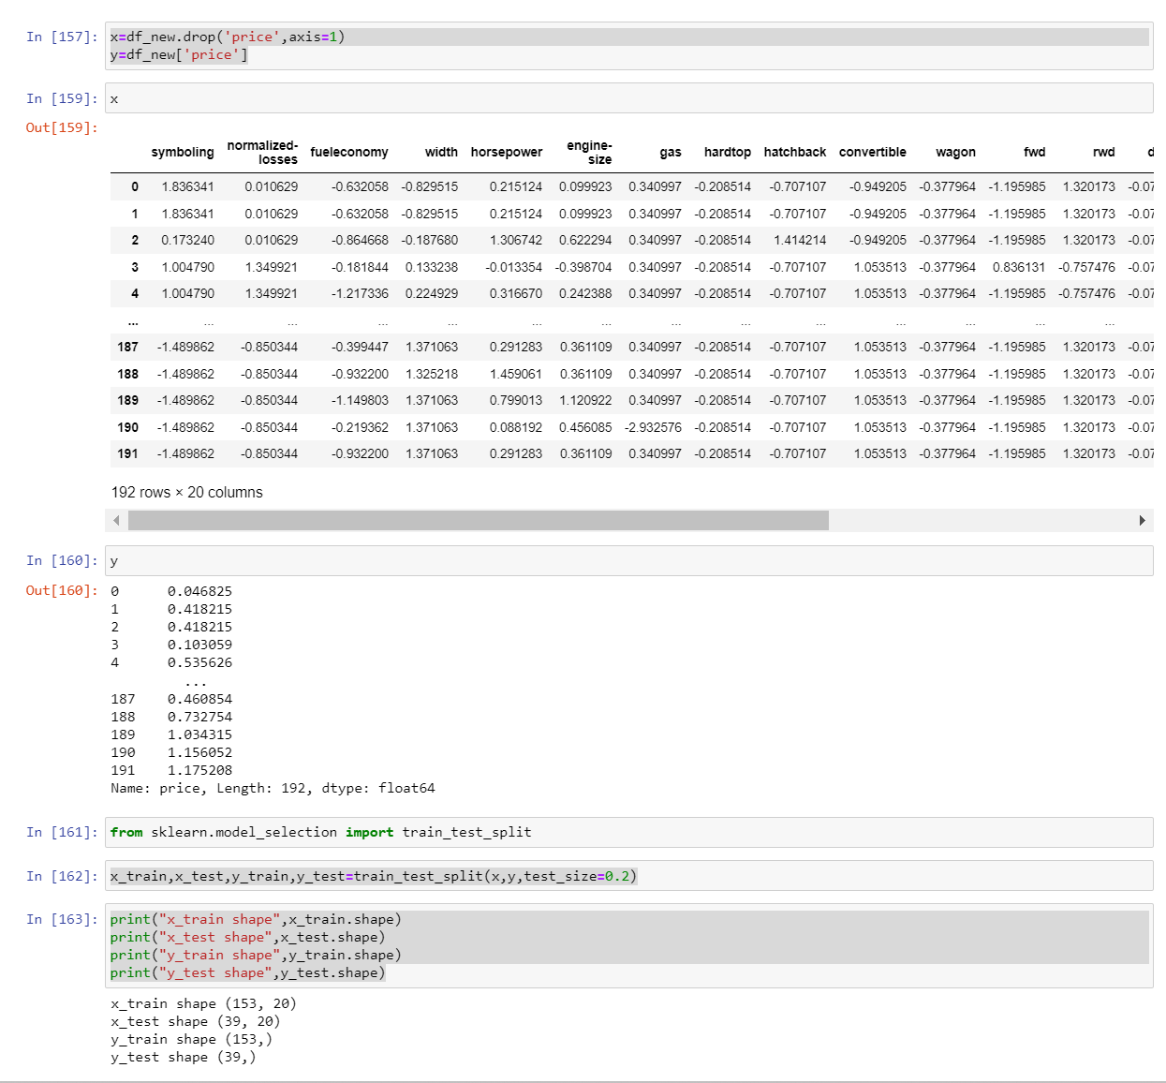
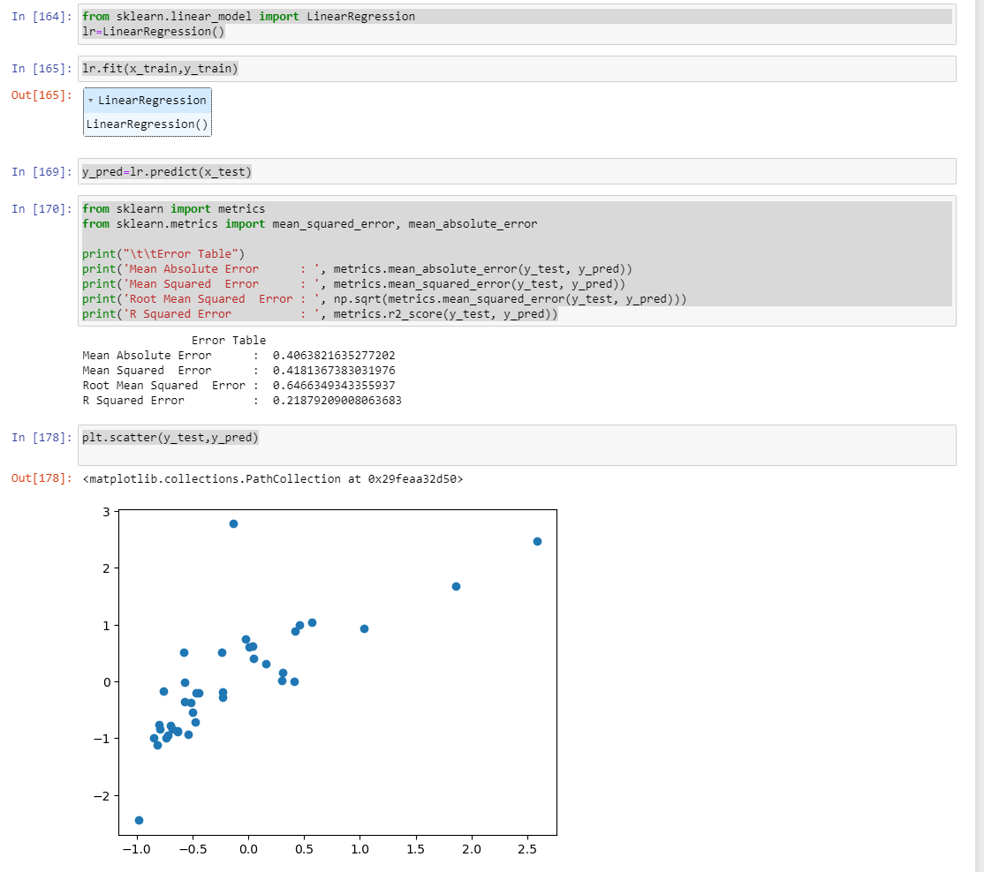
11) Applying Linear Regression model on all attributes of data set

Slide 25
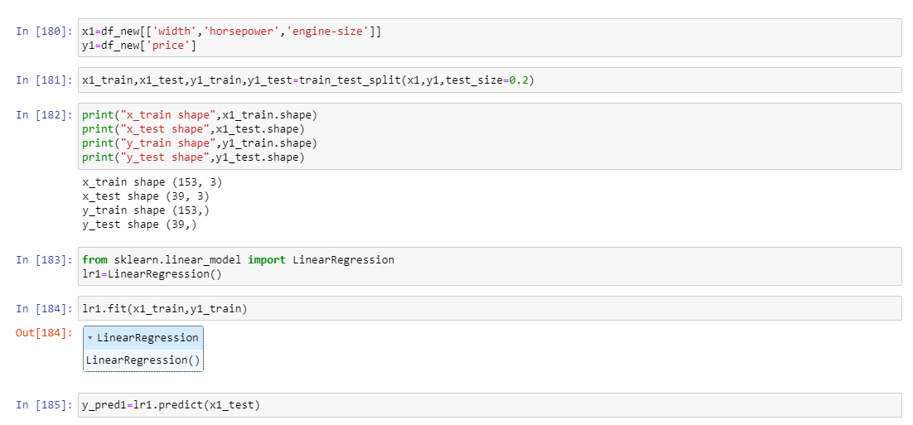
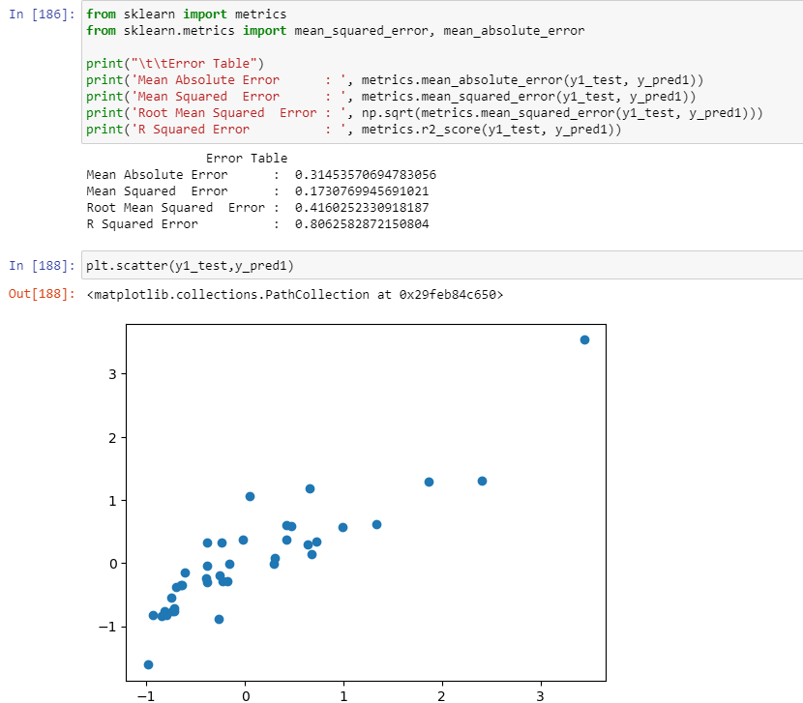
12) Applying Linear Regression model on highly correlated attributes of data set

Slide 26
Thank You

